Slide 1
Why REST?

Slide 2
PROBLEMS WITH WSDL-SOAP
XML can become very verbose
So there is a tradeoff between bandwidth, data transfer, etc
Primarily for heavy duty work
Can transfer binary data through attachments
XML is designed for machine readability
Tedious to debug
Even though tools are available
You don’t need
A supercomputer for browsing facebook
A written contract and registrar for borrowing 10 Rs from a friend
The necessity of webservices have become widespread
Unlike earlier we can imagine using webservices even for simpler things
The advent of smartphones have exacerbated this

Slide 3

REST TO THE RESCUE
Piggybacks on HTTP verbs (we will soon see how)
JSON format though not directly connected to REST, it goes hand-in-hand with the proliferation of RESTFul services
JSON is a pleasure to deal with (Thanks Doug Crockford)
(read) Javascript the good parts
Cons
No machine readable definitions (at least till a while back)
Remember I am old!
Hence, No auto stub generation tools
But we don’t need them anyway
because its simple

Slide 4
Representational state transfer (REST)
The theory of Representatinoal State Transfer – The Architectural Style – By Roy Fielding

Slide 5
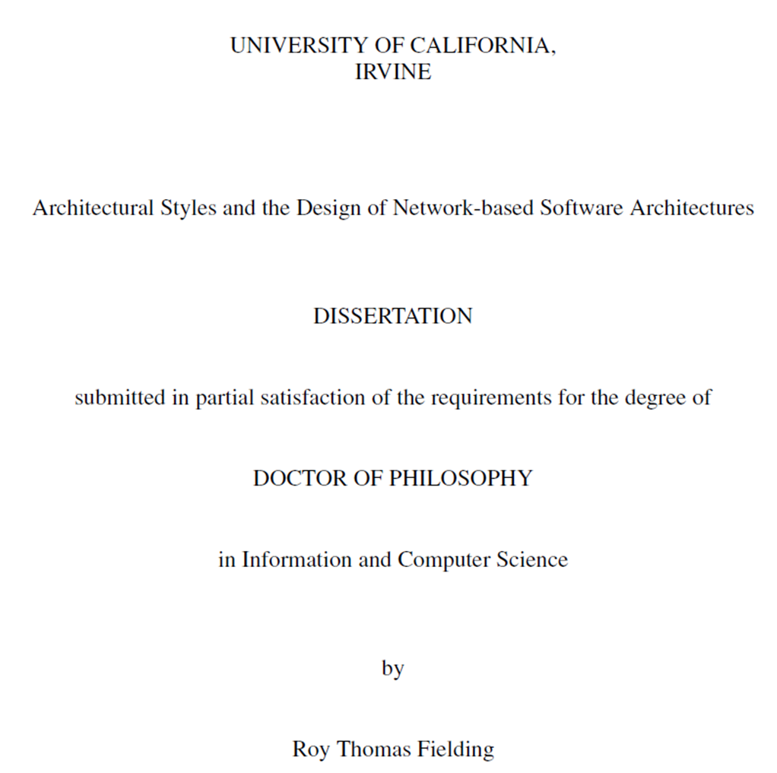
REST
PhD Dissertation of Roy Fielding (2000) at UCI. He was also the chairman of Apache Software foundation and a prolific contributor for WWW as member of W3C. He is one of the authors of HTTP/1.1 specification. Currently Principal Scientist in Adobe

Slide 6
SOFTWARE DESIGN vs NETWORKING RESEARCH
Software Design research
the categorization of software designs and the development of design methodologies
but NOT the impact of various design choices on system behavior
Networking research
Generic communication behavior between systems
Improving the performance of particular communication techniques
But NOT the fact that changing the interaction style of an application can have more impact on performance than the communication protocols.

Slide 7
Fielding’s FOCUS
“ My work is motivated by the desire to understand and evaluate the architectural design of network-based application software through principled use of architectural constraints, thereby obtaining the …properties desired of an architecture. ”

Slide 8
Software Architecture
“A software architecture is an abstraction of the run-time elements of a software system during some phase of its operation. A system may be composed of many levels of abstraction and many phases of operation, each with its own software architecture.”

Slide 9
Software Architecture - Abstraction
At the heart of software architecture is the principle of abstraction
A complex system will contain many levels of abstraction, each with its own architecture.
Architectural elements are delineated by the abstract interfaces
Within each element may be found another architecture
The sub-architecture
Defines the system of sub-elements that implement the behavior represented by the parent element’s abstract interface

Slide 10
Software Architecture - Phases
In addition, a software system will often have multiple operational phases
start-up
Initialization
normal processing
re-initialization
shutdown.
Each operational phase has its own architecture
For example, a configuration file will be treated as a data element during the start-up phase, but won’t be considered otherwise
An overall description of a system architecture should also describe the architecture of transitions between phases

Slide 11
Software Architecture - Elements
Perry and Wolf [105] define processing elements as “transformers of data”
Shaw et al. [118] describe components as “the locus of computation and state.”
“A component is a unit of software that performs some function at run-time. Examples include programs, objects, processes, and filters.”
“A software architecture is defined by a configuration of architectural elements: components, connectors, and data—constrained in their relationships in order to achieve a desired set of architectural properties.”

Slide 12
COMPONENTS, CONNECTORS & DATA
A component is an abstract unit of software instructions and internal state that provides a transformation of data via its interface.
A connector is an abstract mechanism that mediates communication, coordination, or cooperation among components.
A datum is an element of information that is transferred from a component, or received by a component, via a connector.

Slide 13
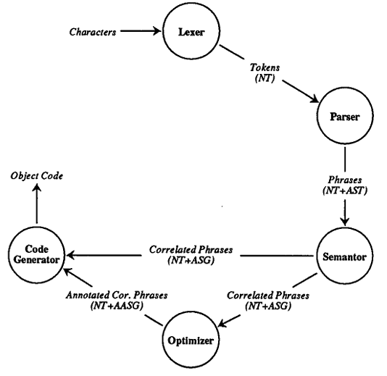
Processing View of Sequential Compiler Architecture
(Perry & Wolf 1992)

Slide 14
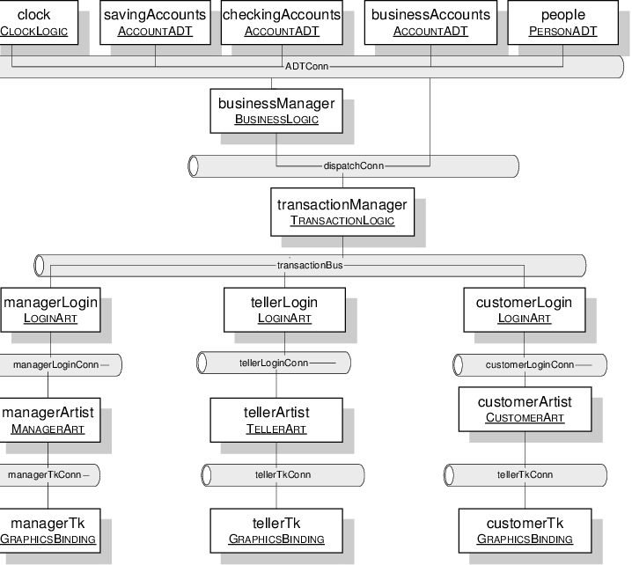

Slide 15
Software architecture vs SOFTWARE structure
There is an important distinction between software architecture and software structure
Software Architecture is an abstraction of the run-time behavior of a software system.
Software Structure on the other hand is a property of the static software source code.
Sometimes the structure may correspond well with the architecture.
But, not always.
Also, this is not a necessary condition

Slide 16
Let’s discuss
Describe an NLP Software (assumed)

Slide 17
Architectural Properties
The set of architectural properties includes all properties that derive from the selection and arrangement of components, connectors, and data.
Functional properties (Application behavior specification)
Non-Functional properties (ease of use, efficiency, etc)
Properties are achieved via architectural constraints (we will see next slide)
The goal of architectural design is to create an architecture with a set of architectural properties that form a superset of the system (functional & non-functional) requirements.

Slide 18
Architectural constraints
Constraints are often motivated by Software design principles/patterns.
Remember these…. constraints
The model is only responsible for managing the data of the application. It receives user input from the controller.
The view is only responsible for rendering presentation of the model in a particular format.
The controller is only responsible for responds to the user input and performs interactions on the data model objects.
If you follow all these constraints, then it can be said that you are adhering to Model-View-Controller Design pattern.

Slide 19
Architectural style
There is no authority. Another name may be “Architectural pattern”
“An architectural style is a coordinated set of architectural constraints that restricts the roles/features of architectural elements and the allowed relationships among those elements within any architecture that
conforms to that style.”

Slide 20
Network based vs DISTRIBUted
Distributed system is one that looks to its users like an ordinary centralized system, but runs on multiple, independent CPUs.
Network-based systems are those capable of operation across a network
but not necessarily transparent to the user.
It may even be desirable for user to be aware of the difference between an action that requires a network request
The focus of Roy Fielding is about Network Based Application Architectures

Slide 21
Network based architecture- Data FLOW styles
Pipe and Filter style (PF)
Each component (filter) reads streams of data on its inputs and produces streams of data on its outputs
Usually while applying a transformation to the input streams and processing them incrementally
So output begins before the input is completely consumed
Uniform Pipe and Filter style (UPF)
Adds the constraint that all filters must have the same interface.
Example: Unix (ish) operating system styles

Slide 22
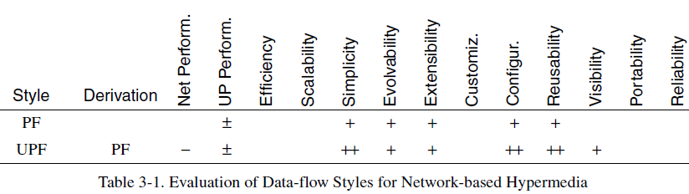
Example of STYLE INDUCED PROPERTIES (PF & UPF)
PF allows the designer to understand the overall input/output of the system as a simple composition of the behaviors of the individual filters (simplicity).
PF supports reuse: any two filters can be hooked together (reusability)
PF systems can be easily maintained and enhanced: new filters can be added to existing systems (extensibility)
In UPF, Restricting the interface allows independently developed filters to be arranged at will to form new applications

Slide 23
Network based architecture- REPLICATION styles
Replicated Repository Style (RRS)
Improve the accessibility of data and scalability of services by having more than one process provide the same service
Provide clients the illusion that there is just one centralized service
Cache Style ($)
A variant of replicated
Replication of the result (response) of an individual request such that it may be reused by later requests

Slide 24
Network based architecture- Hierarchical styles
Client Server Style (CS)
A server component, offering a set of services, listens for requests upon those services.
A client component, desiring that a service be performed, sends a request to the server via a connector.
Layered Client Server Style (LCS)
Each layer providing services to the layer above it and using services of the layer below it
Reduce coupling across multiple layers by hiding the inner layers from all except the adjacent outer layer
Thus improving evolvability and reusability.
Layered-client-server adds proxy and gateway components to the client-server style.

Slide 25
Network based architecture- Hierarchical styles
Client Stateless Server Style (CSS)
Derives from client-server with the additional constraint that no session state is allowed on the server component.
Each request from client to server must contain all of the information necessary to understand the request.
Session state is kept entirely on the client.
Client-Cache-Stateless-Server (C$SS)
Derives from the CSS and adds the $ style
A cache acts as a mediator between client and server
The responses (if cacheable) can be reused

Slide 26
Network based architecture- Hierarchical styles
Layered-Client-Cache-Stateless-Server (LC$CSS)
Derives from both LCS and C$SS through the addition of proxy and/or gateway components.
As you can see, when styles have non-conflicting set of constraints they can be stacked up to create new styles

Slide 27
Network based architecture- MOBILE CODE STYLES
Virtual Machine (VM)
The code must be executed in some fashion, preferably within a controlled environment to satisfy security and reliability concerns
Remote Evaluation (REV)
Derived from the client-server (CS) and virtual machine (VM) styles
A client component has the know-how necessary to perform a service
But client lacks the resources (CPU cycles, data source, etc.) required
The client sends the know-how to a server component at the remote site
The server executes the code using the resources available

Slide 28
Network based architecture- MOBILE CODE STYLES
Code on Demand (COD)
A client component has access to a set of resources, but not the know-how
The client sends a request to a remote server for the code representing that know-how
The server sends it and client receives that code, and executes it locally

Slide 29
Network based architecture- MOBILE CODE STYLES
Layered-Code-on-Demand-Client-Cache-Stateless-Server (LCODC$SS)
Derived by incorporating code-on-demand to the layered-client-cache-stateless-server (LC$SS)
Example Java Applets (extinct – don’t use)

Slide 30
Network based architecture- Other STYLES
Other Hierarchical Styles
Remote session (example: cookies)
Remote Data Access (example: JDBC)
Other Mobile Code Styles
Mobile Agent
Peer to Peer Style
Event Based Integration
C2 Architectural Style
Blackboard architectural style
Many more….But we will focus on the ones that are important for deriving the REST framework

Slide 31
Representational state transfer (REST)
REST is an architectural style for Distributed Hypermedia System
REST is a hybrid style derived from several of the network-based architectural styles seen so far
With one additional (Most) important constraint: Uniform Connector Interface

Slide 32
DERIVING REST
The first constraints added to our hybrid style are those of the client-server architectural style (CS)
Separation of concerns is the principle behind the client-server
Separation allows the components to evolve independently
Separating UI responsibility leads to improved portability (multiplatform)
Next we improve on this to Client Stateless Server style (CSS)
Each request should contain all the server needs
Session state should be maintained entirely on the client
This constraint induces the properties of visibility, reliability, and scalability.

Slide 33
DERIVING REST
Next we improve on this to Client Cache Stateless Server style (C$SS)
If a response is cacheable, then a client cache is given the right to reuse that response data for later, equivalent requests.
This improves efficiency, scalability, and user-perceived performance
Next we improve on this to LC$SS
Layered system style allows an architecture to be composed of hierarchical layers
Each component cannot “see” beyond the immediate layer
This bounds the overall system complexity and promotes substrate independence.
Layers can be used to encapsulate legacy services and to protect new services from legacy clients
The central feature that distinguishes REST is the Uniform Interface style, which we will discuss separately in the next slide

Slide 34
DERIVING REST
Next we add Code on Demand Style to derive (LCODC$CSS)
This allows remote code distribution.
Remember REST is a general architectural style applicable for Networked Hypermedia application software.
We are only interested in REST style as applied to API/Services design, so we will not focus more on this.
Finally, the central feature that distinguishes REST is the Uniform Interface style, which we will discuss separately in the next slide

Slide 35
Uniform interface style
Emphasizes a uniform interface between components
The overall system architecture is simplified and the visibility of interactions is improved
Trade-off: degrades efficiency
Information is transferred in a standardized form rather than one which is specific to the application’s needs.
In order to get a Uniform interface, this is further decomposed into four constraints
REST interface constraints

Slide 36
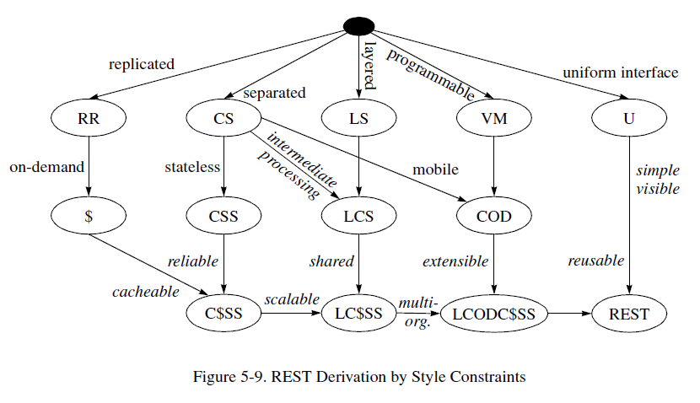

Slide 37
REST INTERFACE CONSTRAINTS
Identification of resources
Manipulation of resources through representations
Self-descriptive messages
Hypermedia as the engine of application state

Slide 38
REST RESOURCE IDENTIFICATION
The key abstraction of information in REST is a resource.
Any information that can be named can be a resource:
a document or image,
a temporal service (e.g. “today’s weather in Los Angeles”)
REST uses a resource identifier to identify the particular resource involved in an interaction between components.
REST relies on the author choosing a resource identifier that best fits the nature of the concept being identified

Slide 39
RESOURCE REPRESENTATION
REST components perform actions on a resource by using a representation to capture the current or intended state of that resource and transferring that representation between components.
A representation is a sequence of bytes, plus representation metadata to describe those bytes
Document, file, and HTTP message entity, etc
The data format of a representation is known as a media type
The resource is a conceptual mapping
the server receives the identifier (which identifies the mapping) and applies it to its current mapping implementation (usually a combination of collection-specific deep tree traversal and/or hash tables)
To find the currently responsible handler implementation
The handler implementation then selects the appropriate action+response based on the request content.

Slide 40
SELF DESCRIPTIVE MESSAGES
Component interactions occur in the form of dynamically sized messages
The most frequent form of request semantics is that of retrieving a representation of a resource (e.g., the “GET” method in HTTP)
which can often be cached for later reuse
REST eliminating any need for the server to maintain an awareness of the client state beyond the current request

Slide 41
“Representational State Transfer” is intended to evoke an image of how a well-designed Web application behaves: a network of web pages (a virtual state-machine), where the user progresses through the application by selecting links (state transitions), resulting in the next page (representing the next state of the application) being transferred to the user and rendered for their use..

Slide 42
Notes on REST DEVELOPMENT
The first edition of REST was developed between October 1994 and August 1995
REST was the means for communicating Web concepts as during HTTP/1.0 specification and the initial HTTP/1.1 proposal.
REST was iteratively improved over the next five years and applied to various revisions and extensions of the Web protocol standards.
REST was originally referred to as the “HTTP object model,” but that name would often lead to misinterpretation of it as the implementation model of an HTTP server.

